Slide 1
Lecture 8
CSE202: OBJECT ORIENTED PROGRAMMING

Slide 2
Outline
Functions(Reference Variable)
Functions(Call by value)
Functions(Call by Reference)
Recursion (Function ,Member Function)

Slide 3



Reference Variable
A reference variable refers to the address of another variable.
A reference variable provides an alias(alternative name) for already defined variable.
A reference variable is created as follows:-
int i=10;
int &b=i;
Now both i and b refer to same variable. The below statements
cout<<i;
cout<<b;
will produce same output i.e. 10.

Slide 4
Reference Variable
A reference variable must be initialized at the time of declaration.
Once a reference variable is declared, it can not refer to any other variable.
#include <iostream>
using namespace std;
int main()
{
int x=11; // variable initialization
int z=67;
int &y=x; // y reference to x
int &y=z; // y reference to z, but throws a compile-time error.
return 0;
}

Slide 5
Reference Variable
We can declare multiple reference variables to the same variable i.e.
int a=10;
int &b=a;
int &c=a;
is allowed. Here b and c are reference variables referring to same variable a . Modifying the value of one of them results in a change in all others.
The following are allowed with respect to reference variables:-
1. int a;
int *ptr=&a;
int &t=*ptr;
2. int &n=50;

Slide 6
Reference Variable
With the help of references, we can easily access the nested data.
#include <iostream>
using namespace std;
struct profile
{
int id;
};
struct employee
{
profile p;
};
int main()
{
employee e;
int &ref=e.p.id;
ref=34;
cout << e.p.id << endl;
}

Slide 7
Reference Variable
In the above code, we are trying to access the 'id' of the profile struct of the employee. We generally access this member by using the statement e.p.id, but this would be a tedious task if we have multiple access to this member. To avoid this situation, we create a reference variable, i.e., ref, which is another name of 'e.p.id'.

Slide 8
Reference Variable
Limitations of References w.r.t. Pointers
1.Once a reference is created, it cannot be later made to reference another object; it cannot be reset. This is often done with pointers.
2.References cannot be NULL. Pointers are often made NULL to indicate that they are not pointing to any valid thing.
3.A reference must be initialized when declared. There is no such restriction with pointers.

Slide 9
MCQ
Which of the following functions must use reference.
C++ References
A | Which of the following functions must use reference A) Assignment operator function
B | B) Copy Constructor
C | C) Destructor
D | D) Parameterized constructor

Slide 10
Solution
Which of the following functions must use reference
A) Assignment operator function
B) Copy Constructor
C) Destructor
D) Parameterized constructor

Slide 11
MCQ
Output of following C++ program?
#include<iostream>
using namespace std;
int main()
{
int x = 10;
int& ref = x;
ref = 20;
cout << "x = " << x << endl ;
x = 30;
cout << "ref = " << ref << endl;
return 0;
}
A)
x = 20
ref = 30
B)
x = 20
ref = 20
C)
x = 10
ref = 30
D)
x = 30
ref = 30

Slide 12
Solution
A)
x = 20
ref = 30
B)
x = 20
ref = 20
C)
x = 10
ref = 30
D)
x = 30
ref = 30

Slide 13
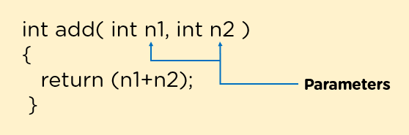
Call by Value(Passing by Value)
To understand call by value we need to understand formal parameters and actual parameters.
Parameters refer to the values that are written inside the parentheses of function call or function header. These values are passed from function call to the function , and a comma separates each parameter from the other parameter. For example, if there is a function for adding two numbers, then that function must have atleast two parameters.

Slide 14
Call by Value(Passing by Value)
Here n1, n2 are the parameters that are passed to the function add().
These parameters are of two types.
Formal parameters: These are those parameters that are written in the function header of definition of a function.
Actual parameters: These are those parameters that are passed while calling the function.
Call by Value Method
Call by Value is a method in which it passes the copies of actual parameters to the formal parameters inside the function. And as it passes the copies, so even if there is any change in the values inside the function, it will not reflect that change in the actual values.

Slide 15
Call by Value(Passing by Value)
#include <iostream>
using namespace std;
void Swap(int a, int b)
{
cout << "Before Swapping:" << endl;
cout << "a: " << a << " b: " << b << endl;
int temp;
temp = a;
a = b;
b = temp;
cout << "After Swapping:" << endl;
cout << "a: " << a << " b: " << b << endl;
}
int main ()
{
int x = 10, y = 20;
swap (x, y);
cout << "x: " << x << " y: " << y << endl;
}
Output:
Before Swapping:
a: 10 b: 20
After Swapping:
a: 20 b: 10
x: 10 y: 20

Slide 16
Call by address(Passing by address)
In this method, the programmer passes the addresses of the actual arguments to the formal parameters. Then, the function uses the addresses to access the actual arguments. The changes made to the formal parameters affect the actual arguments.

Slide 17
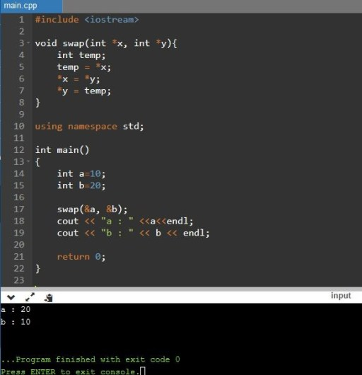
Call by address(Passing by address)

Slide 18
Call by Reference(Passing by Reference)
The call by reference method of passing arguments to a function copies the reference of an argument into the formal parameter. Inside the function, the reference is used to access the actual argument used in the call. This means that changes made to the parameter affect the passed argument.

Slide 19
Call by Reference(Passing by Reference)
#include <iostream>
using namespace std;
// function declaration
void swap(int &x, int &y);
int main ()
{
// local variable declaration:
int a = 100;
int b = 200;
cout << "Before swap, value of a :" << a << endl;
cout << "Before swap, value of b :" << b << endl;
/* calling a function to swap the values using variable reference.*/
swap(a, b);
cout << "After swap, value of a :" << a << endl;
cout << "After swap, value of b :" << b << endl;
return 0;
}
// function definition to swap the values.
void swap(int &x, int &y)
{
int temp;
temp = x; /* save the value at address x */
x = y; /* put y into x */
y = temp; /* put x into y */
return;
}

Slide 20
Call by Reference(Passing by Reference)
Output:
Before swap, value of a :100
Before swap, value of b :200
After swap, value of a :200
After swap, value of b :100

Slide 21
Recursion
When function call itself repeatedly ,until some specified condition is met then this process is called recursion.
It is useful for writing repetitive problems where each action is stated in terms of previous result.
The need of recursion arises if logic of the problem is such that the solution of the problem depends upon the repetition of certain set of statements with different input values an with a condition.

Slide 22
(EXAMPLE)Factorial using recursion
int main()
{
int rec(int);
int n, fact;
cout<<“enter the no.”;
cin>>n;
fact=rec(n);
cout<<“factorial is”<<fact;
}
int rec(int a)
{
int b;
if(a<=1)
{
return(1);
}
else
{
b=a*rec(a-1);
return(b);
}}

Slide 23
Advantages of recursion
It make program code compact which is easier to write and understand.
It is used with the data structures such as linklist, stack, queues etc.
It is useful if a solution to a problem is in repetitive form.
The compact code in a recursion simplifies the compilation as less number of lines need to be compiled.

Slide 24
Disadvantages
Consume more storage space as recursion calls and automatic variables are stored in a stack.
It is less efficient in comparison to normal program in case of speed and execution time
Special care need to be taken for stopping condition in a recursion function
If the recursion calls are not checked ,the computer may run out of memory.

Slide 25
Thank you!
Any doubts?

